Slide 1
Notable.
Making Notes Great Again

Slide 2

Note Taking Sucks, But It Doesn’t Have To.
Microsoft, Apple and Google have developed notes applications and all these notes applications suck.
Microsoft Sticky Notes is the most used note taking app, and it sucks. Want to organise your notes, use it on your phone, or make a template, well if you're using Sticky Notes, too bad. Apple Notes, the iOS and MacOS notes app also shares these limitations.
Notable aims to fix these problems and Make Notes Great Again.

Slide 3
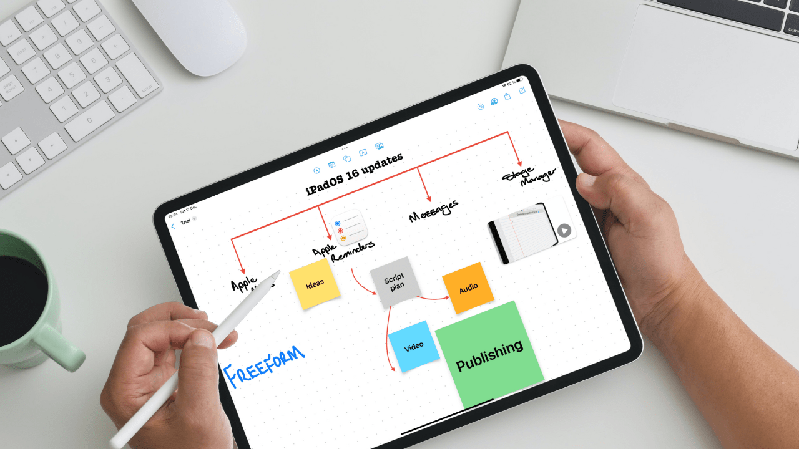
Why Bad Note Taking Is An Issue.
The bad note taking capability provided by Sticky Notes and Apple Notes are an issue because of:
Disorganisation-Lack of organisation capabilities for notes makes it easy to become disorganised and miss deadlines and due dates.
Lack of portability-Being unable to take your notes onto another device severely restricts the ability of people to access their notes on the go.
Lost productivity-Disorganisation and lack of portability result in more inefficient work and lost productivity.

Slide 4
The Notable Advantage.
Notable is the solution to the disorganisation and lack of portability of Sticky Notes and Apple Notes.
Notable Ensures:
Notes are ordered, organised and formatted to make reading them easier.
Notes can be taken anywhere and read or edited on any device.
Productivity lost from the effects of bad notes apps is regained.

Slide 5
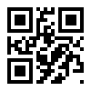
How Notable uses software to be the solution.
Notable uses the approach of a Progressive Web Application (PWA) to ensure that it is easy to use, portable and can use the latest in Rich Text processing software to effectively create and organize notes. Notes are saved locally and to a cloud database so you can access your notes from any device at any time.
Notable features 2 Factor Authentication with a QR code to prevent unwanted access to notes, safeguarding your ideas from prying eyes.

Slide 6
Note taking sucks, but Notable makes sure it doesn’t have to. Notable takes the disorganization and lack of portability out of note taking, making your work more organized and your organization more productive and efficient.

Slide 7
Notable.
Making Notes Great Again

